Slide 1
COMMUNICATION STRATEGIES IN AGRICULTURAL EXTENSION PRRESENTATION BY: GROUP 5 PATRICIA DZIVA B232984A CECILIA TAONEZVI B243001B TENDAI MATONGERA B243681B TAVENGWA MAZARIRE

Slide 2
OUTLINE OF THE PRESENTATION
INTRODUCTION
INDIGENOUS COMMUNICATION PROGRAMMES
MASS MEDIA
INTERPERSONAL
REVIEW OF AGRICULTURAL COMMUNICATION STRATEGIES
RECOMMENDATION
CONCLUSION

Slide 3
INTRODUCTION
DEFINITION OF TERMS
COMMUNICATION
COMMUNICATION STRATEGY
MOBILISATION OF PEOPLE FOR DEVELOPMENT
DISSEMINATION OF NEW TECHNOLOGY AND INFORMATION
FEEDBACK TO THE POLICY MAKERS AND EXTENSION PROVIDERS
A COMBINATION OF STRATEGIES IS POSIBLE

Slide 4
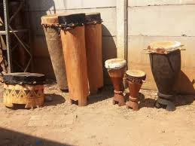
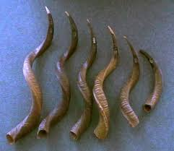
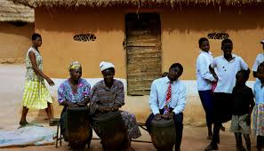
INDIGENOUS COMMUNICATION strategy
CONTINUOUS PROCESS OF INFORMATION DESSEMINATION
SOCIETY IS IN OWNERSHIP OF THE MEDIA
THE VILLAGE HEAD ACTS AS A TRUSTEE
ADIFFERENT FORMS OF COMMUNICATION ,IDIOPHONES
SYMBOLOGRAPHY , SIGNALS ,COLOUR SCHEMES AND MUSIC
MODENASATION OF INDEGENOUS STRATEGIES

Slide 5
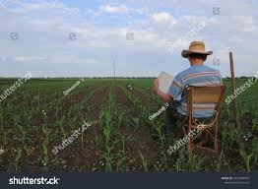


MASS MEDIA STRATEGY
RAPID SPREAD OF INFORMATION FOR EXTENSION
TECHNOLOGY IS USED TO DISSEMINATE INFORMATION
RADIO ,TV,MOBILE PHONES,NEWS PAPER,INTERNET ,HANDOUTS
DISSEMINATE INFORMATION TO A LARGE POPULATION

Slide 6
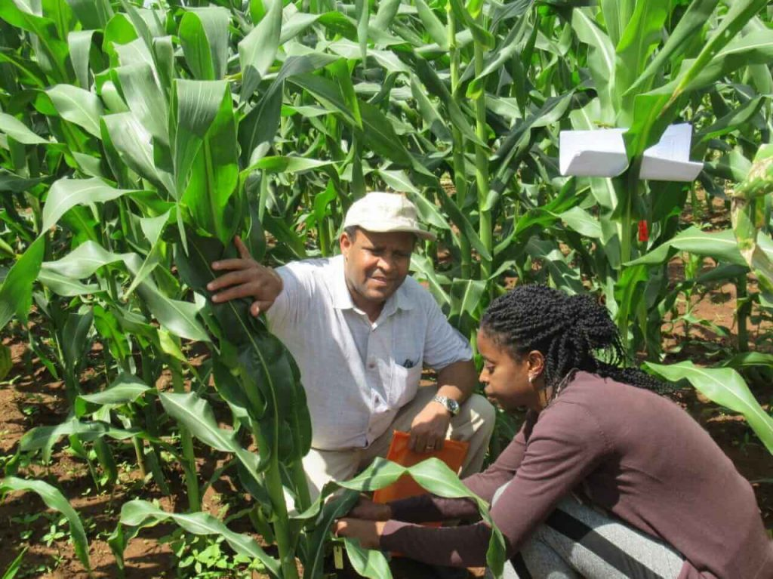
INTERPERSONAL
FACE TO FACE
INDIVIDUAL WHO IS IN FULL CONTROL
MANAGEMENT OF THE ORGANISATION
SCHOOL HEADMASTER
VILLAGE HEAD
OUTSTANDING FARMERS

Slide 7

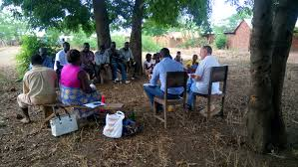
SMALL GROUPS STRATEGY
COMMON OBJECTIVES
FORMS OF MEDIA, VISUAL AIDS, PRACTICAL DEMONSTRATIONS
DIFFICULTY TO MAKE FINAL DECISION
EXTENSION SERVICES IN ZIMBABWE
SECURITY RADIO ON THE FARM
THE GROUPS MAY NOT BE PHYSICAL
ASSOCIATIONS

Slide 8
REVIEW OF AGRICULTURAL COMMUNICATION STRATEGIES
PRE AND POST INDEPENDENCE
CLASSIFICATION OF FARMERS
POLITICAL FACTORS
TECHNICAL FACTORS
CULTURAL FACTORS
EXAMPLES OF SUCCESSFUL PROGRAMES THAT WERE EFFECTIVELY COMMUNICATED

Slide 9

RECOMMENDATIONS
COMBINATION OF STRATEGIES
INTENSIVE PLANNING BEFORE COMMUNICATION
INTERLINK RESEARCH INSTITUTION AND ACADEMICS
SEPERATING POLITICAL INTERESTS AND NATIONAL DEVELOPMENT
FACILITATION OF DEVELOPMENT BY IMPLEMENTING THE STRATEGIES

Slide 10
CONCLUSION
ZIMBABWE HAS A NUMBER OF QUALIFIED EXTENSION SERVICE OFFICERS WITH NO CAPACITY TO FACILITATE DEVELOPMENT DUE TO LACK OF SUFFICIENT RESOURCES
THE MOTIVATION OF RESEARCH INSTITUTION
GOVERNMENT FUNDING PROGRAMMES
MINIMISING CORE DEPENDANCY WITH NGO’s

Slide 11
REFFERENCE
Acunzo, M. (2024). Communication for rural development: Sourcebook Food & Agriculture Organization.
Agbamu, J.U. (2000). Development communication in rural development programmes: The African perspective. The Journal of Development Communication, 11(11), 35-49.
Benor, D.&Harrison, J. 1997. Agriculture extension; the training and visit system. Washington, DC, World Bank.
Hanyani-Mlambo, B.T. Forthcoming, Remodelling intervention: a model for improved research-extension-farmer linkages in smallholder dairying. University of Zimbabwe. (D.Phil.thesis)
Melaku, B.S., Sefereh, E.Y., Emunu, M.H., & Wassie, D.Y. (2024). Application of communication strategies in the diffusion of agricultural innovations and technologies: the case of Amhara Regional Agricultural Research Institute, Ethopia. Cogent Social Sciences, 10(1).
Mudimu,G.D. 1988. Effectiveness of agricultural extension in Zimbabwe: smallholde rfarmers’ assessment of the services. Draft working paper. Department of Agricultural Economics and Extension. University of Zimbabwe.
Nwosu, I.A. (2013). Indigenous communication as an enabling factor for rural development in Nigeria. International Journal of Development and Management .
Tailor and Francis (2023). Analysis of communication approaches used in Agricultural extension: Case of Wolaita Zone, Southern Ethopia.

Slide 12
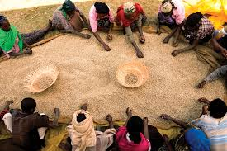
THANK YOU
HANDEI KU NHIMBEE…

